Slide 1
LSD-SLAM: Large-Scale Direct Monocular SLAM
Jakob Engel, Thomas Schöps, Daniel Cremers
Technical University Munich
Oral at ECCV 2014

Slide 2
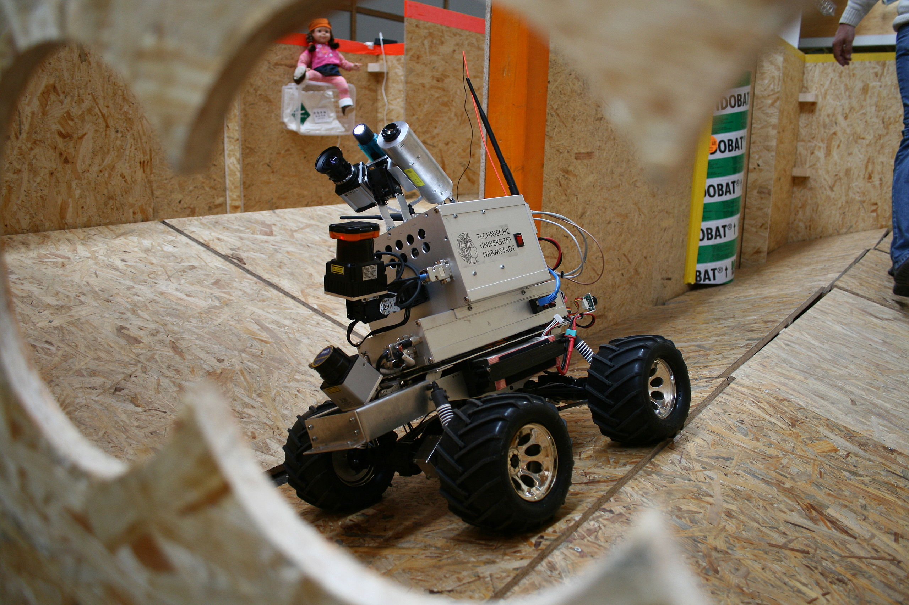
SLAM:
Simultaneous localization and mapping (SLAM) is a technique used by digital machines to construct a map of an unknown environment while simultaneously keeping track of the machine's location in the physical environment. [Wikipedia]

Slide 3
Introduction
SLAM as a research topic is driven by
Robotics (in particular unmanned aerial vehicles)
Virtual/Augmented reality applications
Monocular SLAM: inherent scale ambiguity but potentially great flexibility
Scaled sensors (depth or stereo cameras): limited range, no flexibility

Slide 4
1.2 Contributions and Outline
Large-Scale Direct monocular SLAM
A framework LSD SLAM with novel scale-aware image alignment algorithm
Probabilistically consistent incorporation of uncertainty of the estimated depth into tracking

Slide 5
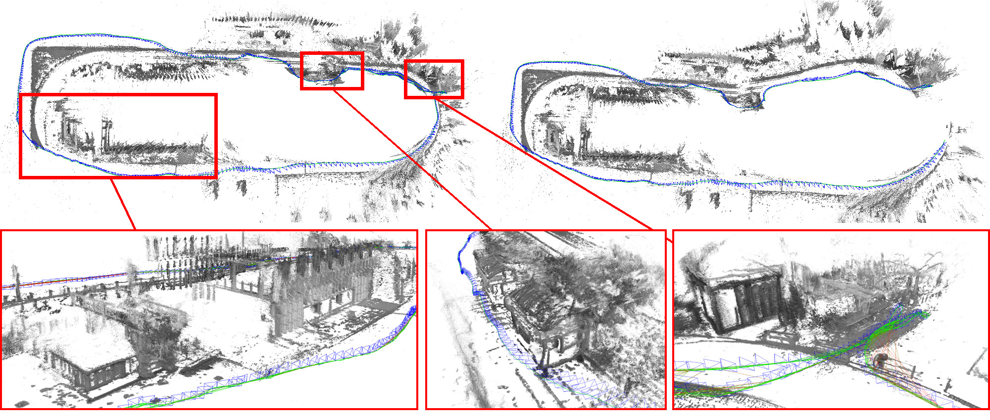
Point clouds
Depth maps

Slide 6
2. Large-Scale Direct Monocular SLAM
Algorithm consists of three major components:
Tracking new Frames
Depth map estimation
Map optimizations

Slide 7
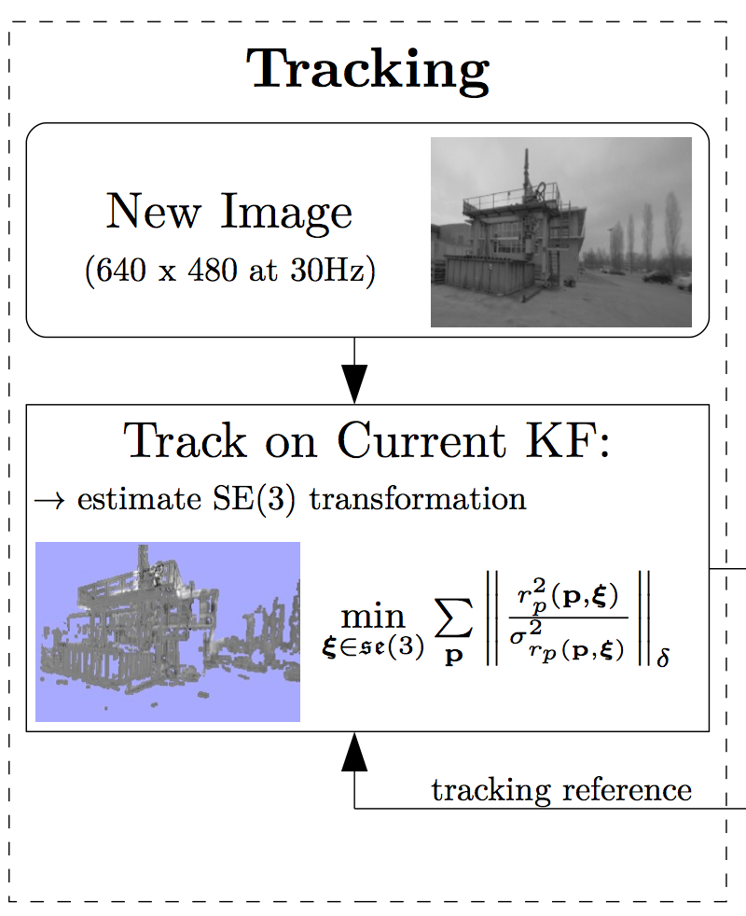
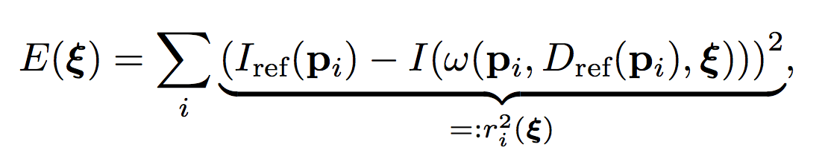
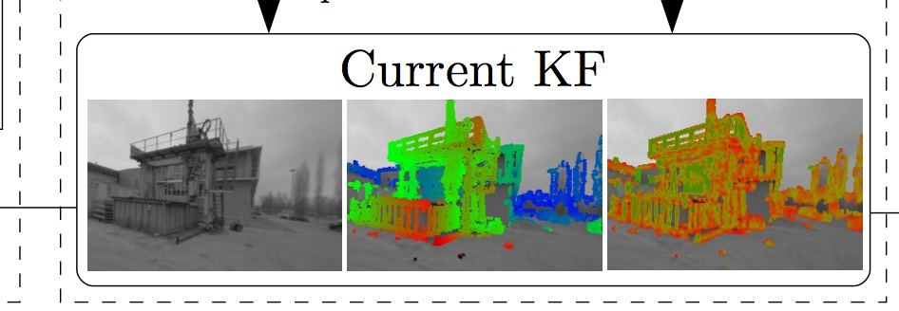
2.1 Tracking new Frames
Continuously track new images, i.e. estimate their rigid body pose with respect to the current key frame (KF)
Use pose of previous frame as initialization
Do this by minimizing photometric error
Gauss-Newton optimization (iteratively re-weighted)
Rigid 3d transformation
Key frame
Weights to improve robustness to outliers (occlusions, reflections)

Slide 8
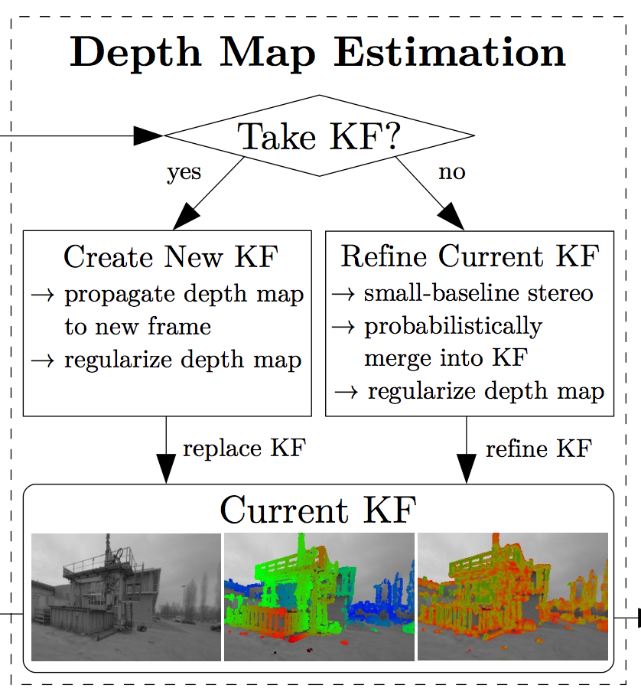
2.2 Depth Map Estimation
Key frame selection: If camera moves too far away from existing map, a new key frame is created from the most recent tracked image (threshold based on weights)
Depth Map Creation: If new KF is chosen, its depth map is initialized by projecting points from the previous KF into it
Depth Map refinement: If tracked frame is not used as new KF, it is used to refine the current KF
The above is done with a high number of very efficient small-baseline stereo comparisons
New Frame

Slide 9
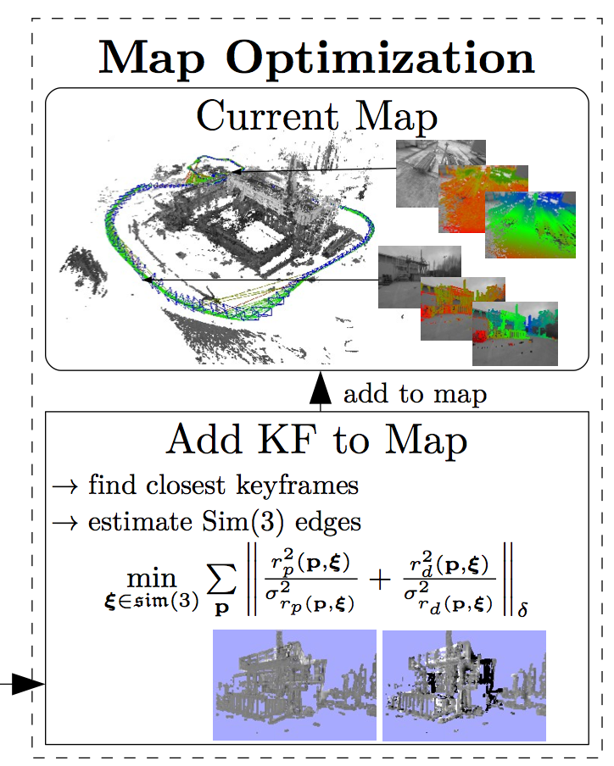
2.3 Map Optimization
The map, consisting of a set of key frames and tracked sim(3)-constraints is continuously optimized in the background using pose graph optimization
SIM(3): the group of affine transformations which are the composition of a rotation, a translation, and a uniform rescaling.
Key Frame

Slide 10
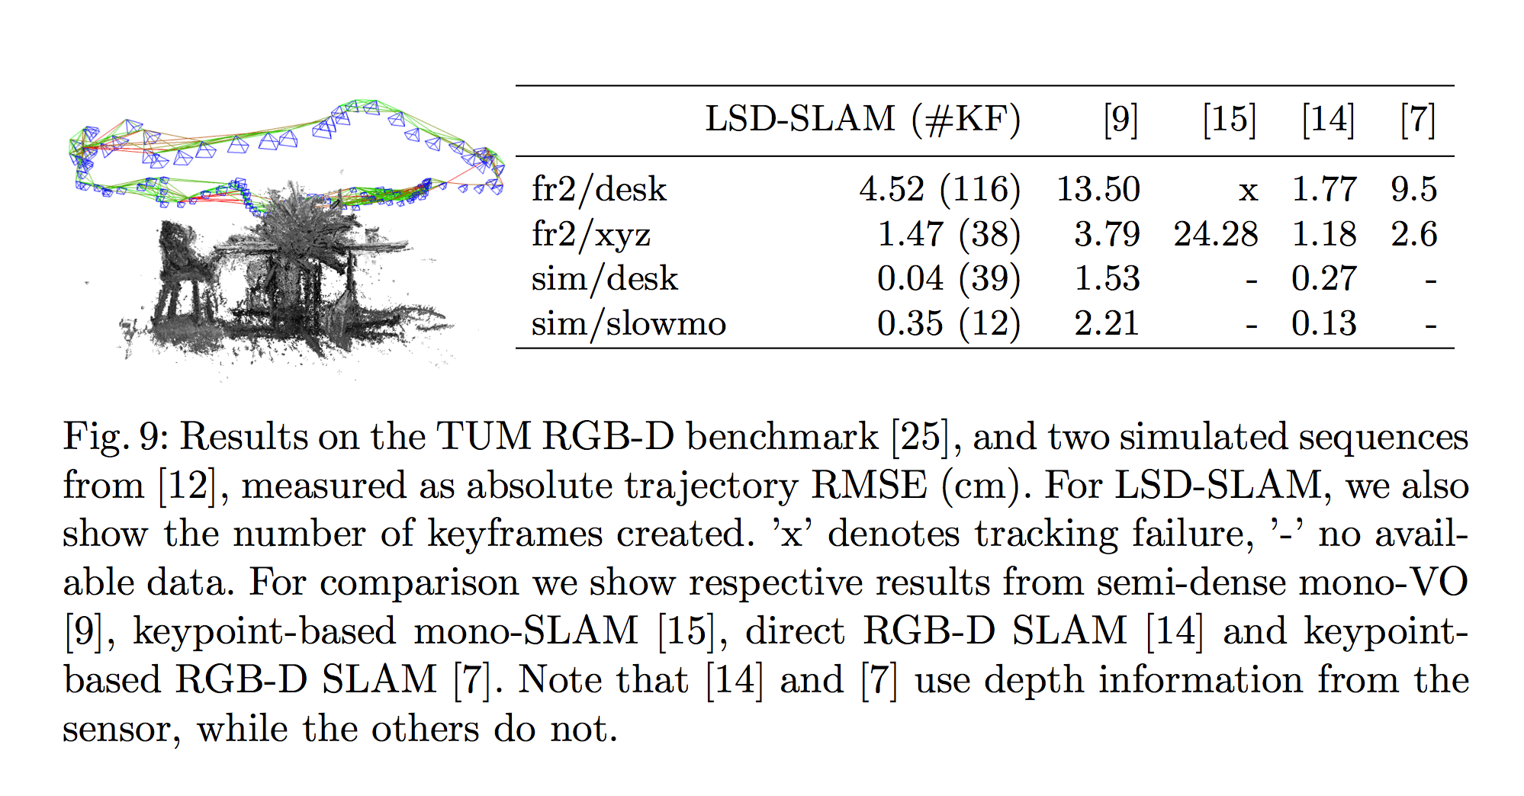
4.1 Quantitative Results

Slide 11
4.2 Qualitative Results
The really cool thing is the scale flexibility, enabling long and challenging trajectories inside and outside:
Room dataset:
http://youtu.be/UacKN2WDLCg
Machine dataset:
http://youtu.be/6KRlwqubLIU
Food court dataset:
http://youtu.be/aBVXfqumTXc

